Slide 1
Insertion Sort
Lecture 2

Slide 2
Insertion Sort
Idea: At step k, put the k^{th} input element in the correct position among the first k elements
Alternate way of saying this:
Sort first element (this is easy)
Now insert 2nd element in order
Now insert 3rd element in order
Now insert 4th element in order
…

Slide 3
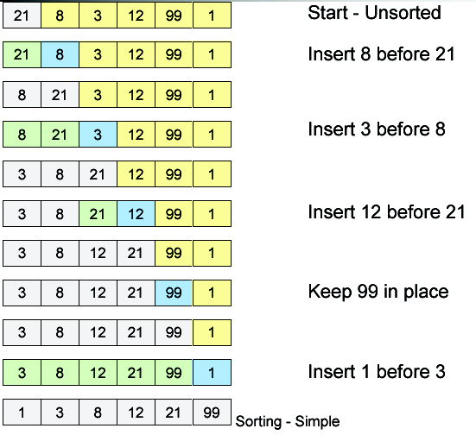
Working

Slide 4
Machine-independent time: An example
A pseudocode for insertion sort ( INSERTION SORT ).
INSERTION-SORT(A)
1 for j ← 2 to length [A]
2 do key ← A[ j]
3 ∇ Insert A[j] into the sortted sequence A[1,..., j-1].
4 i ← j – 1
5 while i > 0 and A[i] > key
6 do A[i+1] ← A[i]
7 i ← i – 1
8 A[i +1] ← key

Slide 5

Example of Insertion Sort

Slide 6
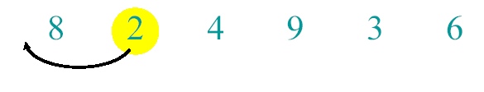
Example of Insertion Sort

Slide 7
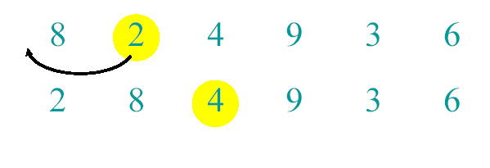
Example of Insertion Sort

Slide 8
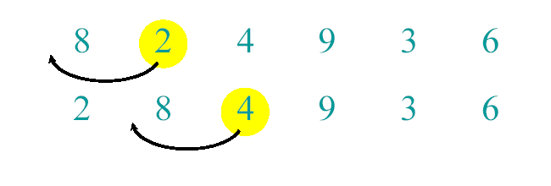
Example of Insertion Sort

Slide 9
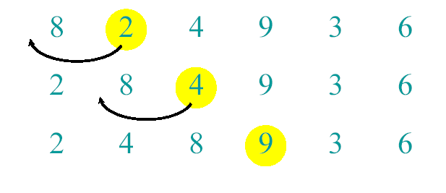
Example of Insertion Sort

Slide 10
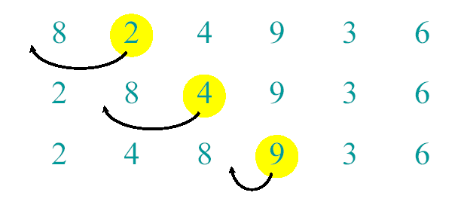
Example of Insertion Sort

Slide 11
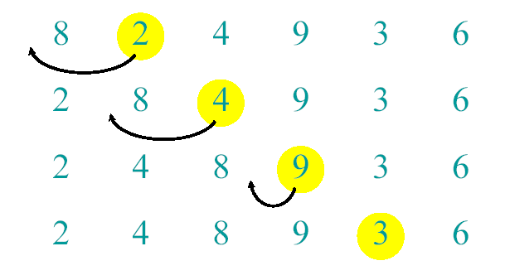
Example of Insertion Sort

Slide 12
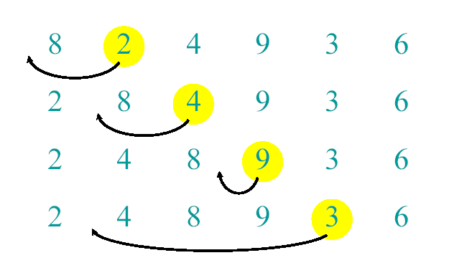
Example of Insertion Sort

Slide 13
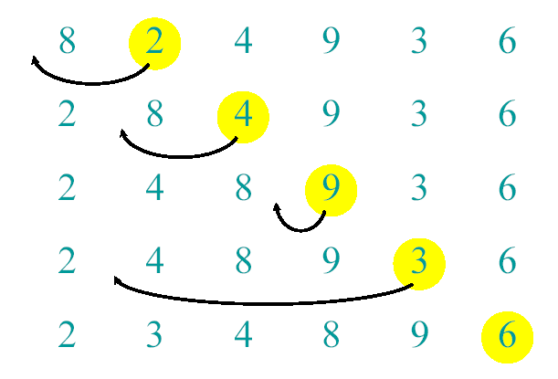
Example of Insertion Sort

Slide 14
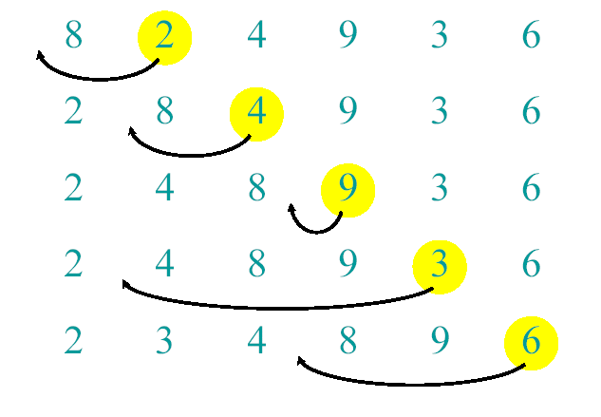
Example of Insertion Sort

Slide 15
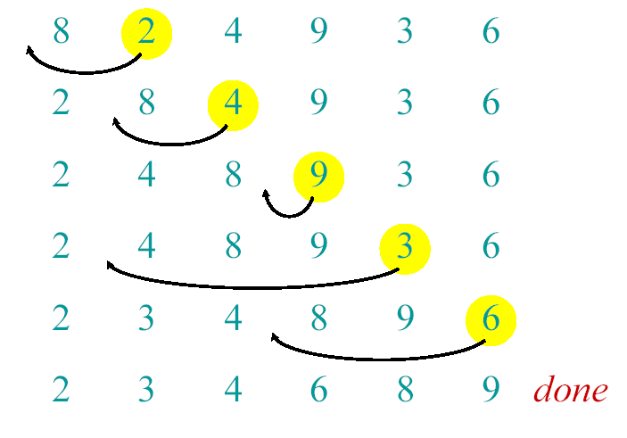
Example of Insertion Sort

Slide 16
Loop Invariants
Invariants – statements about an algorithm that remain valid
We must show three things about loop invariants:
Initialization – statement is true before first iteration
Maintenance – if it is true before an iteration, then it remains true before the next iteration
Termination – when loop terminates the invariant gives a useful property to show the correctness of the algorithm

Slide 17
Example: Insertion Sort
Invariant: at the start of each for loop, A[1…j-1] consists of elements originally in A[1…j-1] but in sorted order
for j=2 to length(A)
do key=A[j]
i=j-1
while i>0 and A[i]>key
do A[i+1]=A[i]
i--
A[i+1]=key

Slide 18
Example: Insertion Sort
Invariant: at the start of each for loop, A[1…j-1] consists of elements originally in A[1…j-1] but in sorted order
for j=2 to length(A)
do key=A[j]
i=j-1
while i>0 and A[i]>key
do A[i+1]=A[i]
i--
A[i+1]:=key
Initialization: j = 2, the invariant trivially holds because A[1] is a sorted array.

Slide 19
Example: Insertion Sort
Invariant: at the start of each for loop, A[1…j-1] consists of elements originally in A[1…j-1] but in sorted order
for j=2 to length(A)
do key=A[j]
i=j-1
while i>0 and A[i]>key
do A[i+1]=A[i]
i--
A[i+1]:=key
Maintenance: the inner while loop finds the position i with
A[i] <= key, and shifts A[j-1], A[j-2], …, A[i+1] right by one position.
Then key, formerly known as A[j], is placed in position i+1 so that A[i]
and A[i+1] < A[i+2].
A[1…j-1] sorted + A[j]
A[1…j] sorted

Slide 20
Example: Insertion Sort
Invariant: at the start of each for loop, A[1…j-1] consists of elements originally in A[1…j-1] but in sorted order
for j=2 to length(A)
do key=A[j]
i=j-1
while i>0 and A[i]>key
do A[i+1]=A[i]
i--
A[i+1]:=key
Termination: the loop terminates, when j=n+1. Then the invariant states: “A[1…n] consists of elements originally in A[1…n] but in sorted order.”

Slide 21
A pseudocode for insertion sort ( INSERTION SORT ).
INSERTION-SORT(A)
1 for j ← 2 to length [A]
2 do key ← A[ j]
3 ∇ Insert A[j] into the sortted sequence A[1,..., j-1].
4 i ← j – 1
5 while i > 0 and A[i] > key
6 do A[i+1] ← A[i]
7 i ← i – 1
8 A[i +1] ← key

Slide 22
Analysis of INSERTION-SORT(contd.)

Slide 23
Analysis of INSERTION-SORT(contd.)
The total running time is

Slide 24
Analysis of INSERTION-SORT(contd.)
The best case: The array is already sorted.
(t_{j} =1 for j=2,3, ...,n)

Slide 25
Analysis of INSERTION-SORT(contd.)
The worst case: The array is reverse sorted
(t_{j} =j for j=2,3, ...,n).

Slide 26
Time Complexity
Best Case Sorted array as input, [ O(N) ]. And O(1) swaps.
Worst Case: Reversely sorted. when inner loop makes maximum comparisons, [ O(N²) ] and O(N²) swaps.
Average Case: [ O(N²) ] and O(N²) swaps.

Slide 27
Class Activity
Q1: write a program in C language to print the average of 5 numbers.
Numbers are 5,8,11,14,17
List total number of primitive operations performed in this program
Calculate total running time
Q2: write a program in C language that sorts the data in an array of 10 elements using insertion sort and then searches for some specific key in that data.
Calculate the time complexity of this program
for elements of array that are in reverse order and
the key which is almost at the mid of the array

Slide 28
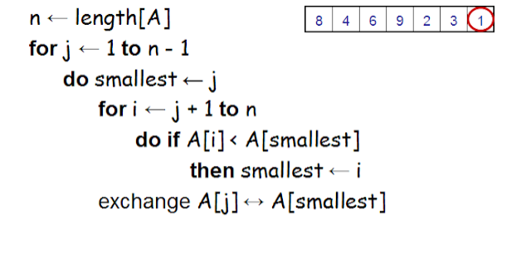
Cont…

